Slide 1
CHAPTER 1
LOGIC
PROBLEM SOLVING

Slide 2
QUIZ
Can you apply a deductive thinking ?
Only fish oil contains Omega 3
Only foods that contain Omega 3 help with brain development.
Which conclusion can be derived from these 2 statements?
A - All fish oils help with brain development
.
B - Only what contains Omega 3 is fish oil.
C - All that helps with brain development is fish oil
.
D - There are fish oils that help with brain development.

Slide 3
QUIZ
Can you apply a deductive thinking ?
Only fish oil contains Omega 3
Only foods that contain Omega 3 help with brain development.
Fish oil
- All fish oils help with brain development
Not all fish oil contains Omega3 !!
Food with Omega 3

Slide 4

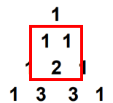


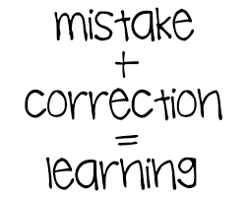
EXPLAIN
Think Before You Start Doing
1 - UNDERSTAND
2 - CREATE A STRATEGY
?
?
?
Read the problem
carefully
Draw
diagrams
Question everything
interpret repetitive patterns.
Lok for details
Learn from mistakes

Slide 5
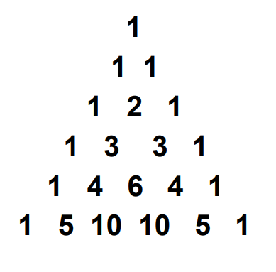
EXPLAIN
Example : “Find the next line in the sequence”

Slide 6
EXPLAIN
Step 1 : we find the pattern

Slide 7
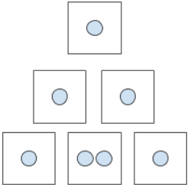
EXPLAIN
Step 2 : we draw some diagram to understand
+
It look like the two dots are the sum of two ones.

Slide 8
EXPLAIN
Step 3 : we check our idea work everywhere
YES !

Slide 9
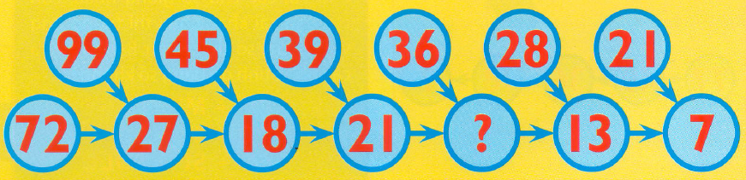
Apply this process to find the missing number

Slide 10
We found a pattern…. Then we check if it works everywhere
2 + 1 + 1 + 3 = 7

Slide 11


PRACTICE
ACTIVITY
15 MIN
Triangles

Slide 12
EXPLORE
ACTIVITY
15 MIN
Tower of Hanoi
https://www.mathsisfun.com/games/towerofhanoi.html

Slide 13
PRACTICE
ACTIVITY
15 MIN
Zebra puzzle
Start by reading all the clues
Find all the "basic" clues and mark them.
Example: The German lives in house three.
Deduce some information using two or more clues;
https://www.brainzilla.com/logic/zebra/einsteins-riddle/

Slide 14
PRACTICE
THE GARDEN
ZEBRA PUZZLES

Slide 15
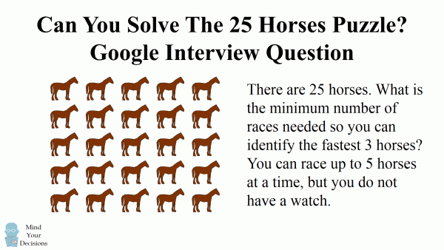
PRACTICE

Slide 16
PRACTICE
Find out everyone's full name
Four children (Ann, Sam, Henry, Kendra) have different last names (Smith, Jones, Gonzales, Lee).
Use the following clue to help you figure this out:
a. Ann's last name does not have a "z" in it.
b. Sam's last name does not end with an "s".
c. Henry's last name has 5 letters in it.
d. Sam's last name is not the shortest one here.

